Slide 1
Amazon Sales Data Analysis Report
By Pomesh Verma

Slide 2
Objectives
To create a report on Sales Trend Year wise, Month-wise to understand the factors directly affecting the sales and gain competitive advantage acquiring good chunk of market share.

Slide 3
Data Description
The dataset consists of following columns:
1. Discount Amount: Discount on every ordered item
2. Date: Ordered Date 3. Item: Name of the item ordered
4. List Price: The price at which the item is listed.
5. Sales Amount: Total amount of sales for particular item.
6. Sales Cost Amount: Amount spent for conversion of Sale
7. Sales Margin Amount: Margin amount on each item sold
8. Sales Quantity: Total number of items sold
9. Sales Representative: Representative under whom sale is completed.

Slide 4

Tools Used
● Programming Language: Python
● Python Libraries: NumPy, Pandas
● Business Intelligence Tools: Excel, Power BI

Slide 5
Data Import & Data Cleaning
Import the given excel file in Jupyter Notebook for cleaning
Data Cleaning is a crucial as the dataset has impurities such as missing values or incorrect data types.
We used Pandas library in Python to impute/remove missing values and make dataset ready for creating visual reports

Slide 6
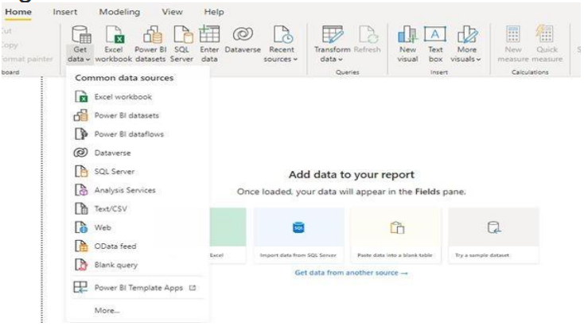
Data Importing in Power BI
In Power BI, we have options to connect to our dataset via various options such as SQL Server, MYSQL, excel or CSV files.
We have our clean data in CSV file. We will import it in Power BI with import data option and start working with it.

Slide 7
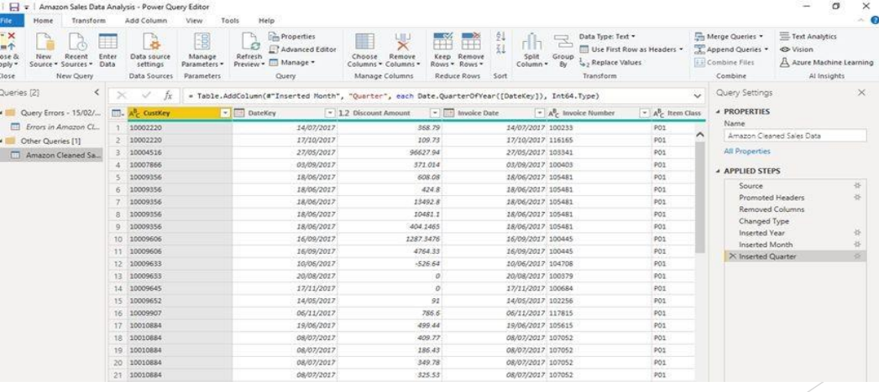
Data Transformation in Power BI
Once the data is imported in Power BI, we do ‘transform data’ i.e. using Power Query editor to perform certain operation on to the data .
Ensuring correct data types, creating Custom/conditional columns are some fundamental task performed in Power Query.

Slide 8
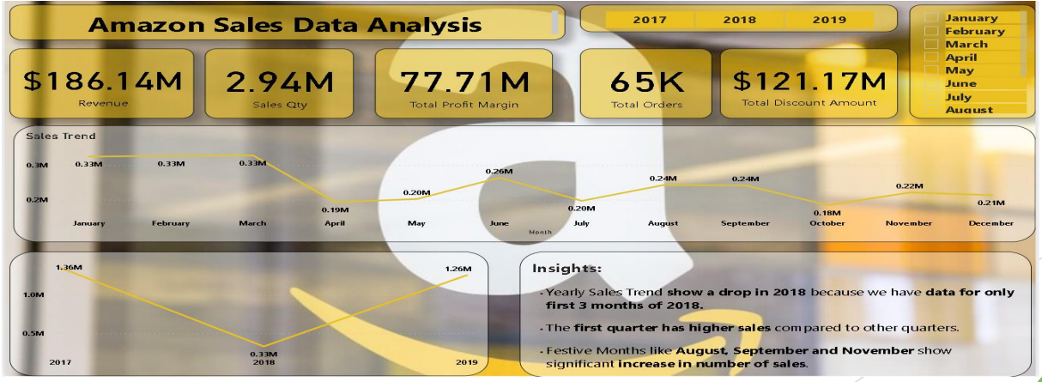
Building Visuals in Power BI
A report is created in Power BI with various charts depicting Sales insights for particular year, month and so on.
We created Slicers, Data Cards, Sales Trend for Year and Month, Table for top ordered item, top performing sales representatives and relationship between different variables.

Slide 9
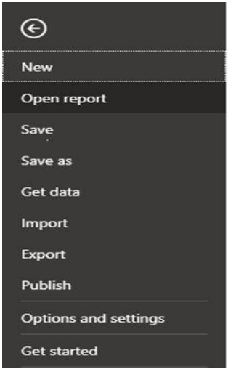
Deployment in Power BI
In Power BI, You can directly publish the report online to your workstation. If you do not have the work email-id then you can save the file in ‘.pbix’ version. This helps another viewer see your work and understand the story or insights you’re communicating

Slide 10
Thank-You

